Slide 1
Diffie Hellman Key Exchange

Slide 2
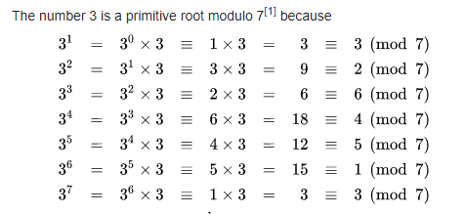
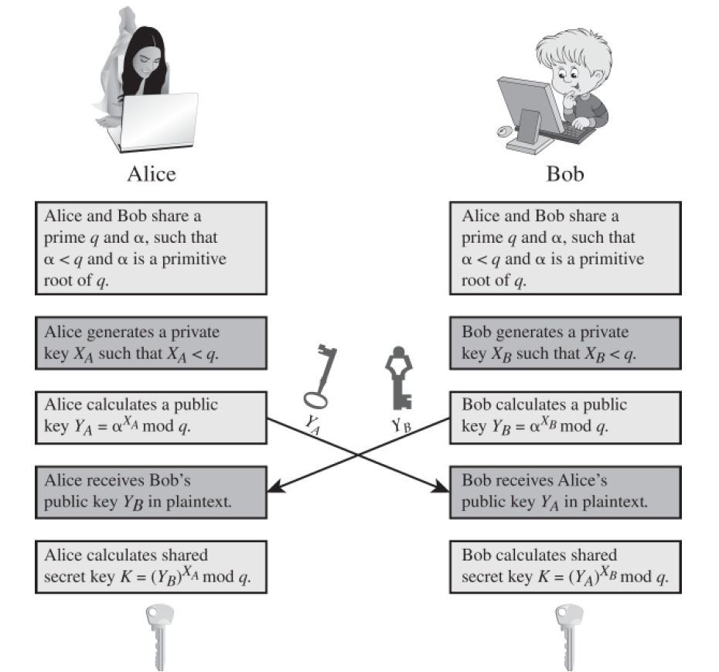
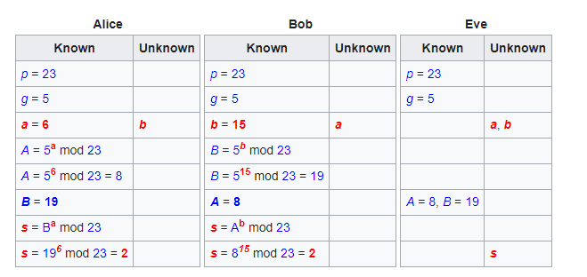
Primitive Roots
Remember, (gª)^{b} = (g^{b})ª = g^{ab}

Slide 3
Supplemental Viewing
https://www.youtube.com/watch?v=NmM9HA2MQGI
https://www.youtube.com/watch?v=Yjrfm_oRO0wd

